Slide 1
Digital Health – a connected community
Code-a-Thon
10/19/2016

Slide 2


Digital Health – a convergence of people, information, technology and connectivity in healthcare
‹#›

Slide 3
Technology in healthcare is becoming truly impactful
Moving healthcare from the clinic to the patient
Seeking to Understand of the patient’s behavior and physiology
Focusing on prevention
Leveraging computing power and connectivity
‹#›

Slide 4
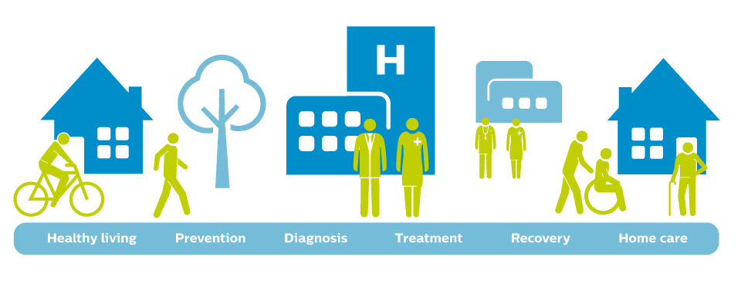
Across the Health Care Continuum
10/5/2016
‹#›

Slide 5
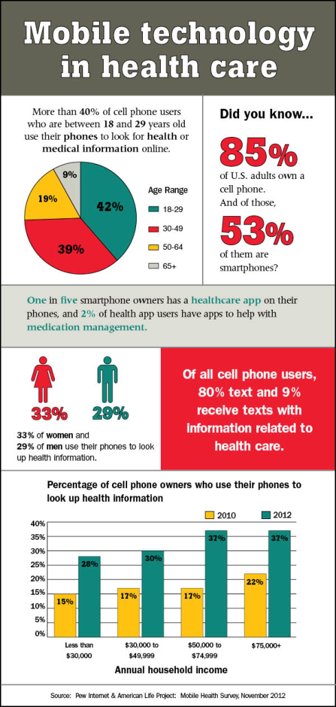
As of May 2014, there were nearly 7 Billion
mobile subscriptions worldwide
An equivalent 95.5 percent of the world population have a mobile subscription.
Nearly 1 billion handheld units were shipped in 2013 (up 42%+ from 2012) … 53.6 percent were smartphones.
Sources: International Telecommunication Union – May 2014, Gartner – February 2014.
‹#›

Slide 6
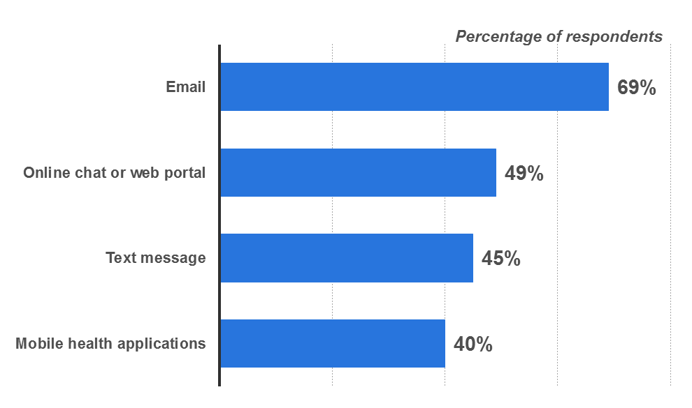
Healthcare providers and consumers are using technology to communicate
Consumers are willing to use selected technologies to communicate with healthcare providers
(Fall 2013 U.S. based survey)
Source: Statista 2015 (http://www.statista.com/statistics/297827/healthcare-providers-and-consumers-use-of-communication-technolog/)
‹#›

Slide 7

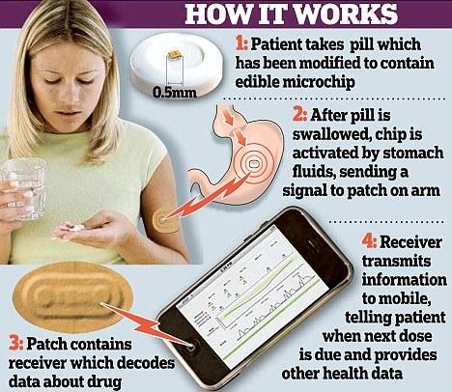
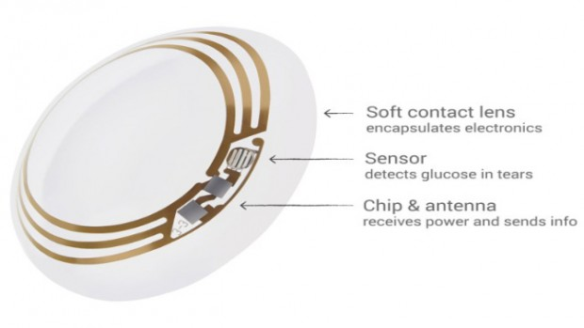
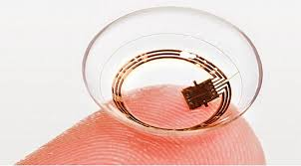
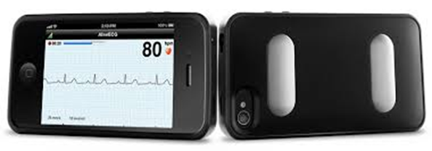
Mobile health
10/5/2016
‹#›

Slide 8

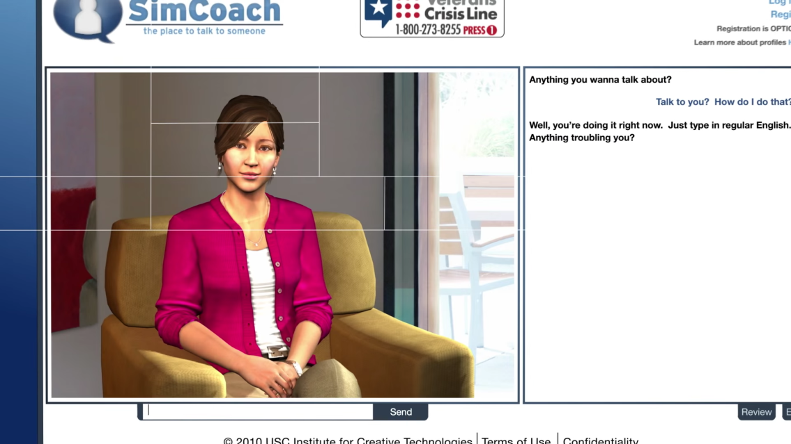


Reaching across the Continuum
10/5/2016
‹#›

Slide 9

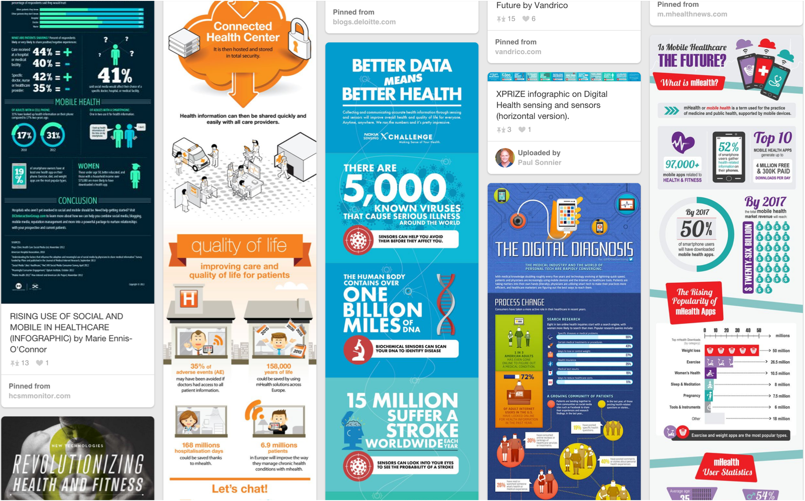
Enable “patient centered” public health as digitization touches every aspect of health care
Foster trust in innovative technologies as an enabler of a new healthcare paradigm
Partner with stakeholders to be "digital-future ready”
CDRH Objectives
‹#›

Slide 10
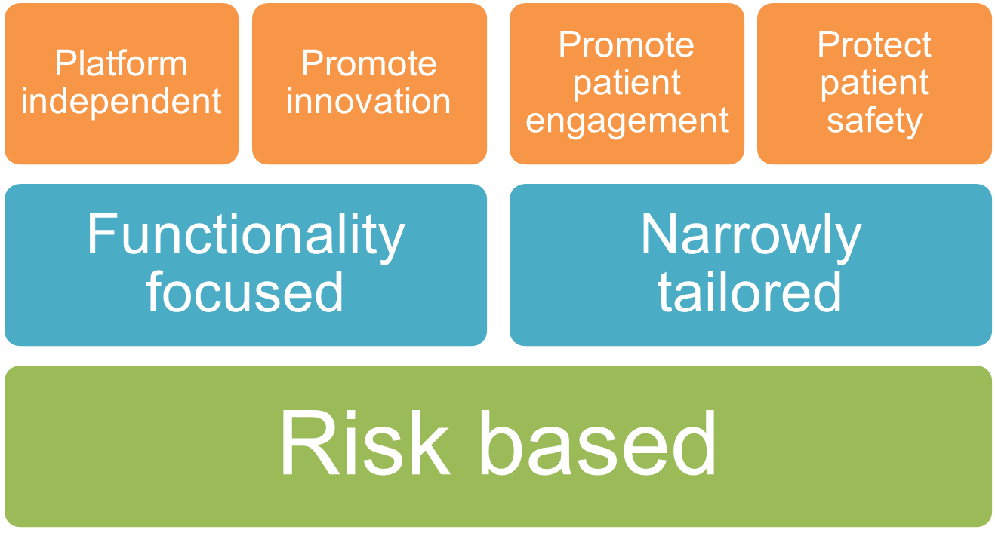
Smart policies
‹#›

Slide 11
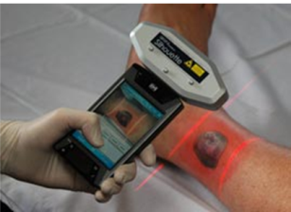
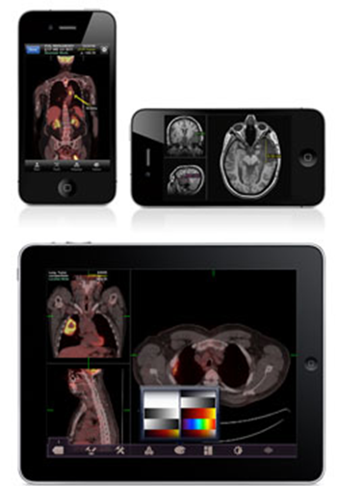
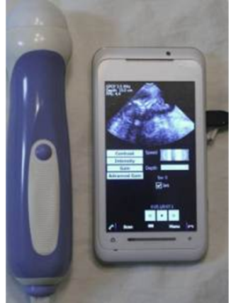
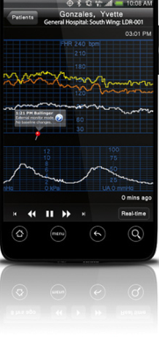
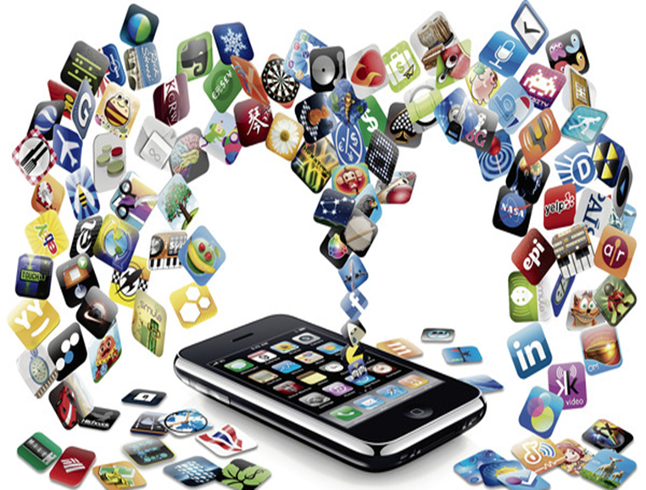
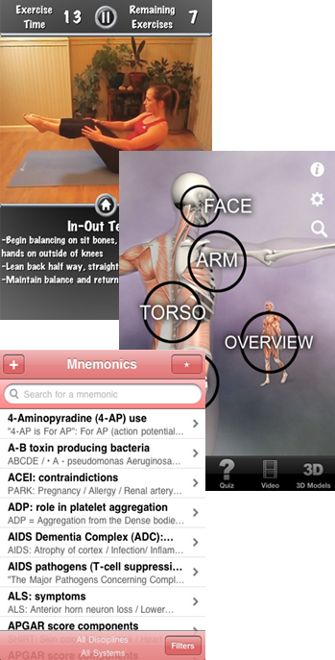
approach towards Mobile Medical Apps (MMA)
Patient self-management apps
Tools to organize and track their health information (not for treating or adjusting medications)
Tools to access to health information document and communicate with health care providers
Tools that automate simple health care providers tasks
MMA
Focus of oversight
Not focus of oversight
Mobile apps that meet “device” definition that are either intended
To be used as an accessory to already regulated medical device, or
To transform a mobile platform into a regulated medical device.
Lower risk
mobile apps that
meet “device” definition
but not considered “MMA”
Mobile apps not
considered
“medical devices”
No regulatory requirements
‹#›

Slide 12
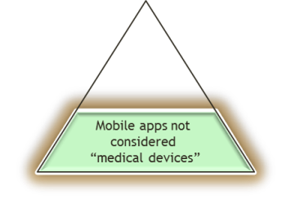
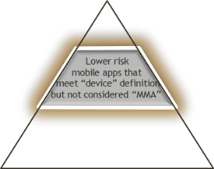
Examples of Mobile Apps Not the focus for FDA
Mobile apps –
NOT Medical Devices
Mobile apps –
NOT Focus of Oversight
Library of clinical descriptions
Medical flash cards
Certification or recertification preparation apps;
Games to train health professionals in advanced CPR skills.
Allow users to input pill shape, color or imprint and displays pictures and names of pills that match this description;
Find the closest medical facilities;
Help guide patients to ask appropriate questions to their physician
Track, review and pay medical claims and bills online;
Manage or schedule hospital rooms or bed space
Help patients (i.e., users) self-manage their disease or conditions without providing specific treatment or treatment suggestions;
Provide patients with simple tools to organize and track their health information;
Provide easy access to information related to patients’ health conditions or treatments;
Help patients document, show, or communicate potential medical conditions to health care providers;
Automate simple tasks for health care providers; or
Enable patients or providers to interact with Personal Health Record (PHR) or Electronic Health Record (EHR) systems.
‹#›

Slide 13
Mobile Medical Apps (MMA)
“mobile medical app” is a mobile app that meets the definition of device in section 201(h) of the Federal Food, Drug, and Cosmetic Act (FD&C Act) ; and either is intended:
to be used as an accessory to a regulated medical device; or
to transform a mobile platform into a regulated medical device
Examples in Section V-A + Appendix C
MMA
focus of oversight
‹#›

Slide 14
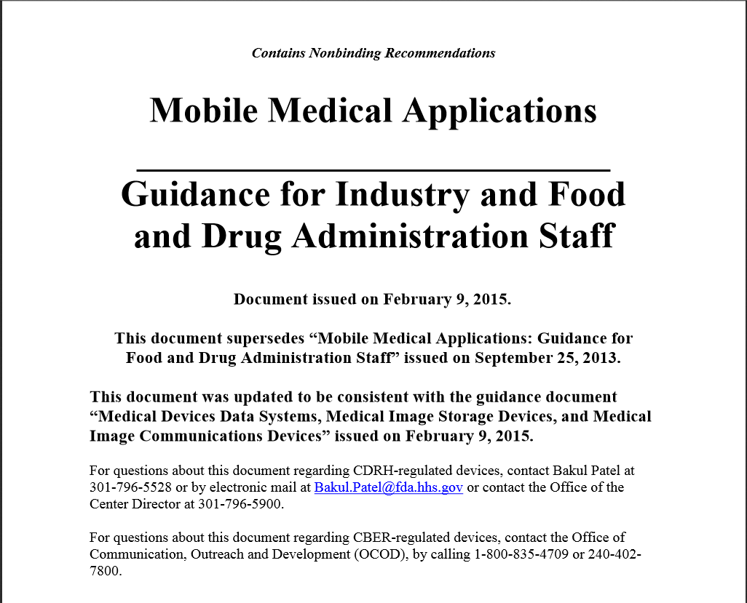

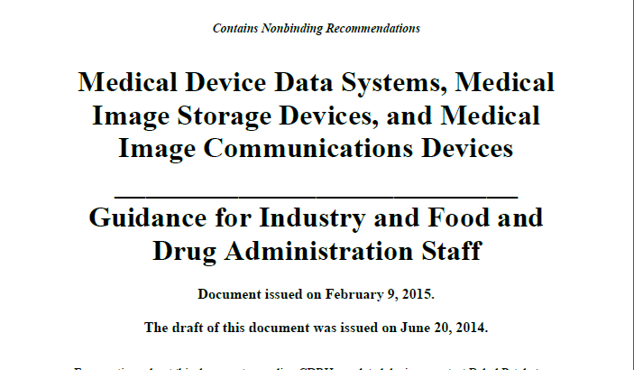
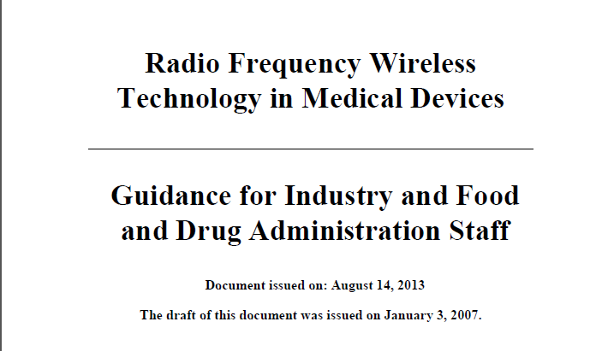
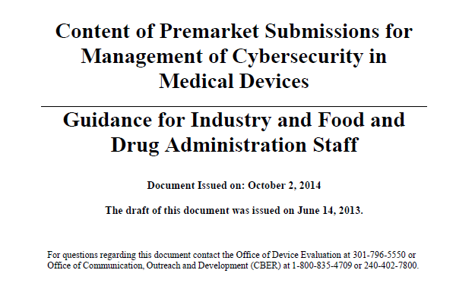
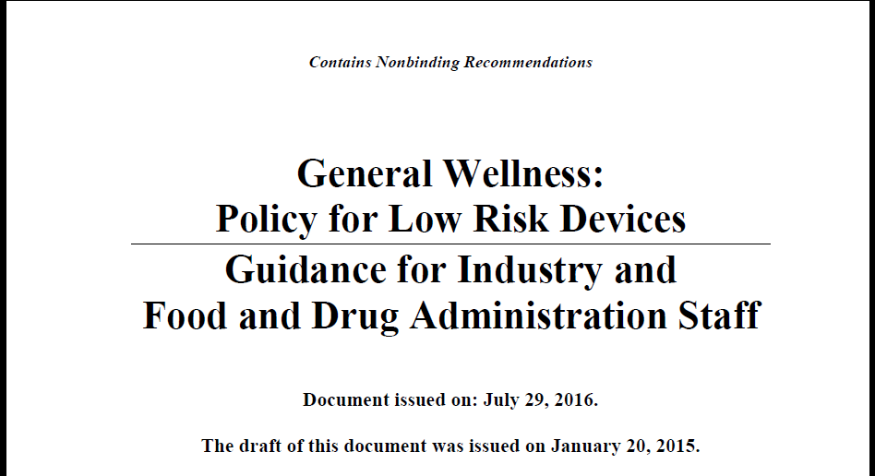
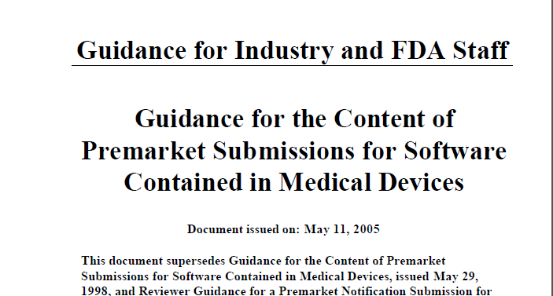
Tools available from FDA

Slide 15
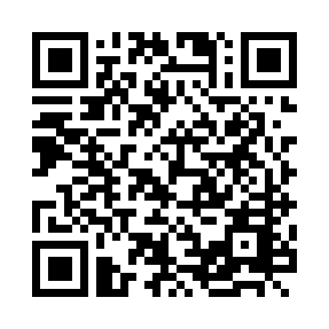
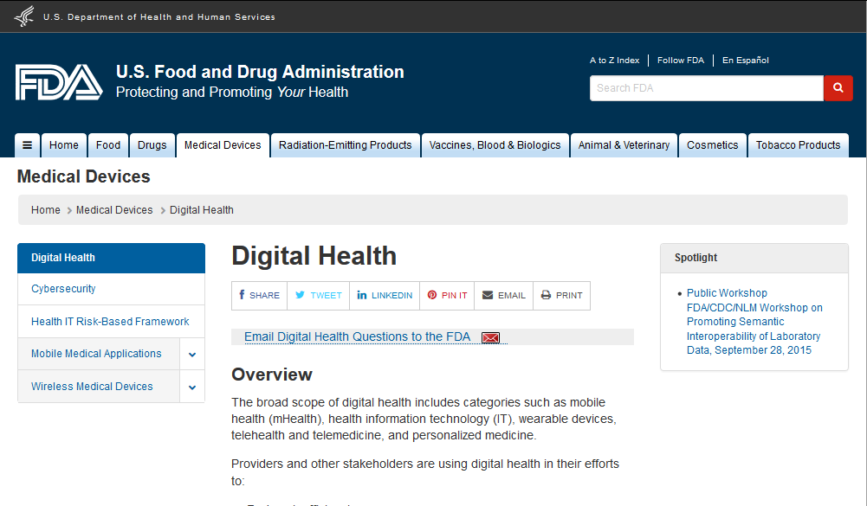
Digital Health Contact
Digital Health and Mobile Apps email
DigitalHealth@fda.hhs.gov
CDRH websites
Digital health page
http://www.fda.gov/MedicalDevices/DigitalHealth/default.htm

Slide 16
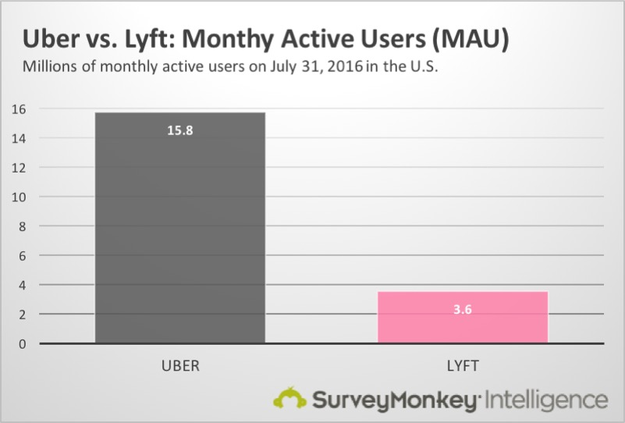
This challenge – tear a page from “uber-fication”
10/5/2016
‹#›

